Slide 1
Combined Stakeholder Group
Q3 2018 Meeting
August 24, 2018 (9AM – 1:30PM)

Slide 2
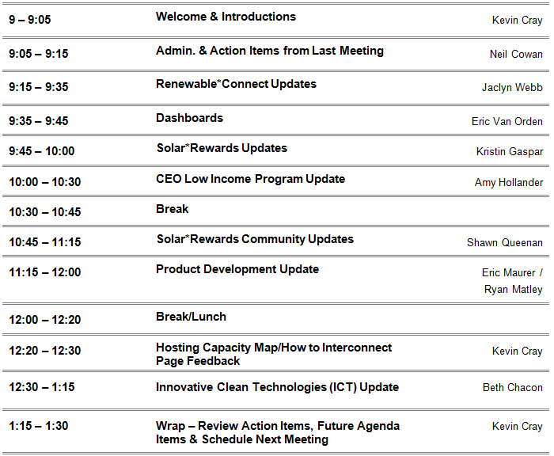
AGENDA
Combined Stakeholder Group

Slide 3
Admin. & Action Items from Last Meeting
Combined Stakeholder Group
Transitioning from Windsource® to Renewable*Connect
(Brett Jackson, CO Army National Guard)
Renewable Program Dashboards maybe add the installed numbers?
(Justin Wilson, CEC/COSEIA)
S*RC Low Income RFP Scoring
(Sub-Group Meetings to take place)
3

Slide 4

Renewable*Connect
Combined Stakeholder Group
Phase I subscriptions: 10,234 kW
  2,800 customers
Phase II availability: 39,766 kW
  36 customers
  Allocated a percentage of initial request
Contracting
Waitlist available
Solar resource online December 2018
Notes:
More details on website

Slide 5
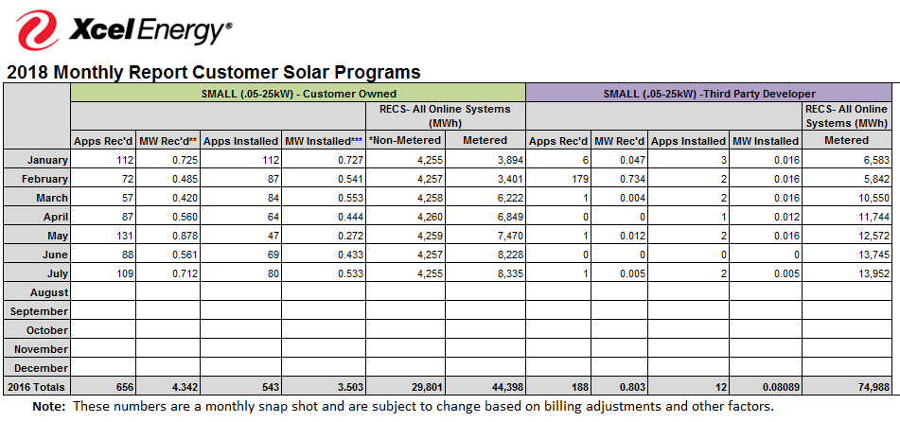
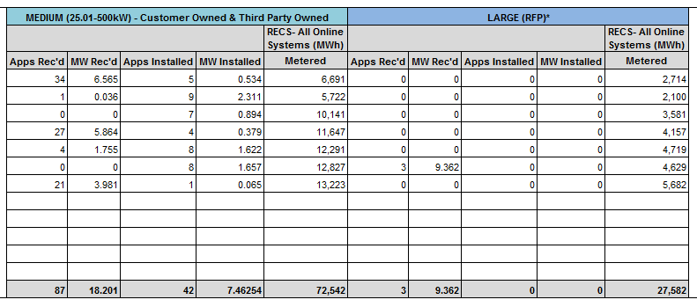
Numbers in the dashboards
Combined Stakeholder Group
EXAMPLE “CUMULATIVE REPORT”
FILED WITH THE PUC MONTHLY

Slide 6
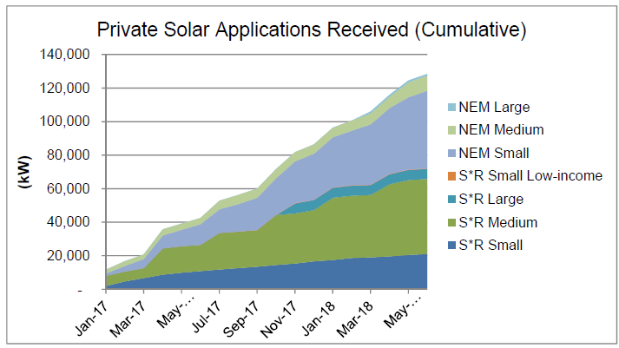
Solar*Rewards & Net Metering Only Dashboard
Combined Stakeholder Group
Notes:
Keep in mind that we are giving you the raw data to stay current and dynamic. The cleaned up data with numbers are in the Monthly “Cumulative” Report.
We’ll see if the NEM Medium projects come to fruition. But, small are very likely.
We haven’t talked much about Large. But, those projects are gaining momentum. IBM for ~4 and 6 MW and two Amazon sites for 5.4 MW. 0.638 MW could roll into 2019.

Slide 7
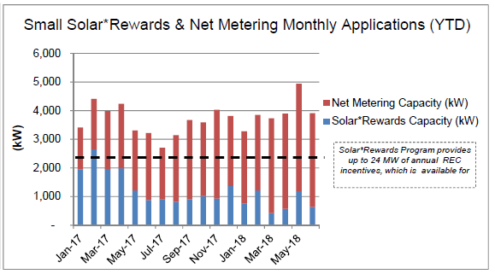
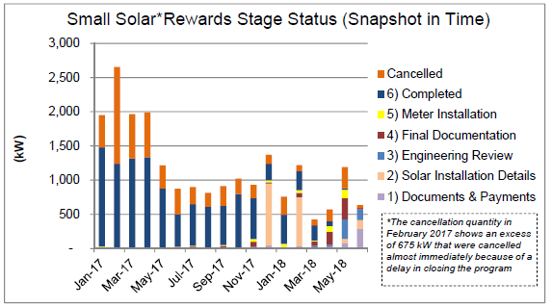
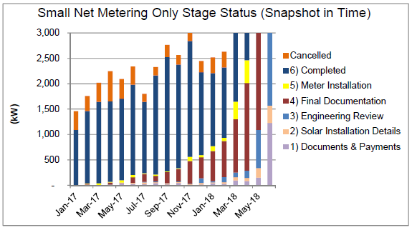
Solar*Rewards & Net Metering Only Dashboard
Combined Stakeholder Group
Notes:
Continue to see NEM. But, Solar*Rewards Small hasn’t gone away.
Talk about CEO Low-income Later

Slide 8
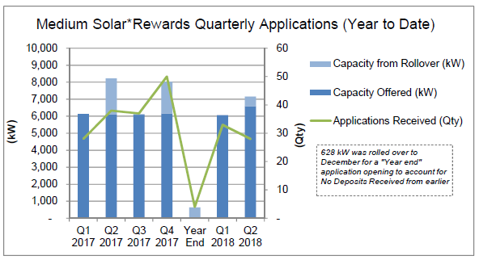
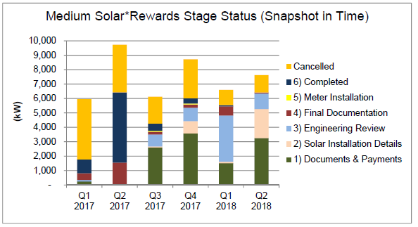
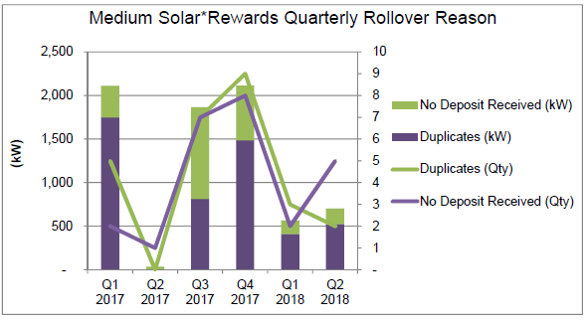
Solar*Rewards & Net Metering Only Dashboard
Combined Stakeholder Group
Notes:
Continue to meet Medium capacity each month
Much of the orange is Duplicates and No Deposits which roll forward. You can see that capacity shrinking over time.
Medium for Q3 still has X capacity. Expect it to sell out, eventually. Are there any thoughts or reactions about International Tariffs impacting this? Podcast on EnergyGang amount I being hard to standardize (some of that being the financing).

Slide 9
Solar*Rewards Large and Medium Update
Combined Stakeholder Group
Large Solar*Rewards RFP
2017 Award: One 6 MW project awarded, progressing for completion in 2019
2018 Award: Three projects awarded for 9.362 MW. One project is ~4 MW at the same site as the 2017 award
Medium Solar*Rewards Q3 program still open
Open 47 days and counting
24 projects @ 3.5 MW
~2 MW remaining
9

Slide 10
On-site Battery Storage – Project Status
Combined Stakeholder Group
Application Stage | Count
Solar Installation Details | 4
Documents and Payments | 13
Engineering Review | 16
Final Documentation | 111
Meter Installation | 19
Completed | 130
Grand Total | 293
10

Slide 11

Low-Income Solar PV
Colorado Energy Office
for the Solar Stakeholder Meeting at Xcel Energy
August 24, 2018

Slide 12
Colorado Energy Office
Overview
Our Mission
To deliver cost-effective energy services and advance innovative energy solutions for the benefit of all Coloradans.
Low Income &
Residential Energy
Services
Commercial &
Industrial Energy
Services
Transportation
Fuels &
Technology
Public Affairs
Notes:
The Colorado Energy Office’s mission is to deliver cost effective energy services and advance innovative energy solutions for the benefit of all Coloradans.
To achieve that mission, the Office is divided into 4 programmatic units that provide programs and services to specific customer classes.
The Low-Income and Residential Energy Services Unit works to maximize energy cost savings to residential customers across the income spectrum and increases access for residents to energy efficiency and renewable energy improvements. This includes everything from free weatherization services for low-income customers to finance products for energy improvements in homes, as well as technical assistance for jurisdictions for adopting more efficient energy building codes.
The Commercial and Industrial Energy Services Unit works to make energy efficiency and renewable energy projects accessible and affordable to consumers in this sector including agricultural operators, public and commercial building owners, industrial operations, and K-12 schools.
The Transportation Fuels and Technology Unit works to advance and increase alternative fuel vehicles in the state through policy and planning, infrastructure funding, and education and outreach to consumers.
The Public Affairs Unit engages with stakeholders from all energy sectors to develop inclusive energy policy recommendations and information for the administration, the legislature, the Public Utilities Commission, and the general public. The information gathered through these efforts informs our programming in other units and ensures that we are providing relevant, useful energy services and solutions for the state.

Slide 13
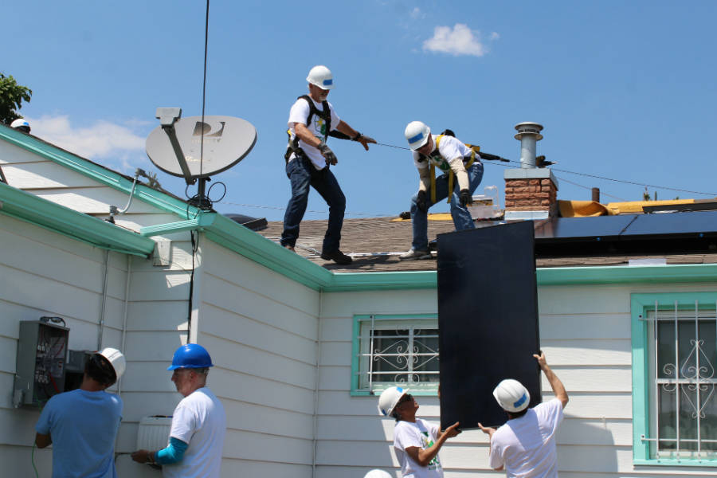
Colorado Becomes First Weatherization State to Install Solar
Inside Climate News July 2, 2018 by Dan Gearino
Solar Is Saving Low-Income Households Money in Colorado. It Could Be a National Model.
The results can make a big difference for residents like Joe Anderson, whose power bills have been cut by two-thirds since 13 solar panels were installed free-of-charge on his ranch-style house under one Colorado program. "I felt like I kind of got the luck of the draw," he said.
https://insideclimatenews.org/news/02072018/colorado-rooftop-solar-panels-clean-energy-utility-bill-savings-low-income-households-weatherization
Notes:
https://insideclimatenews.org/news/02072018/colorado-rooftop-solar-panels-clean-energy-utility-bill-savings-low-income-households-weatherization

Slide 14
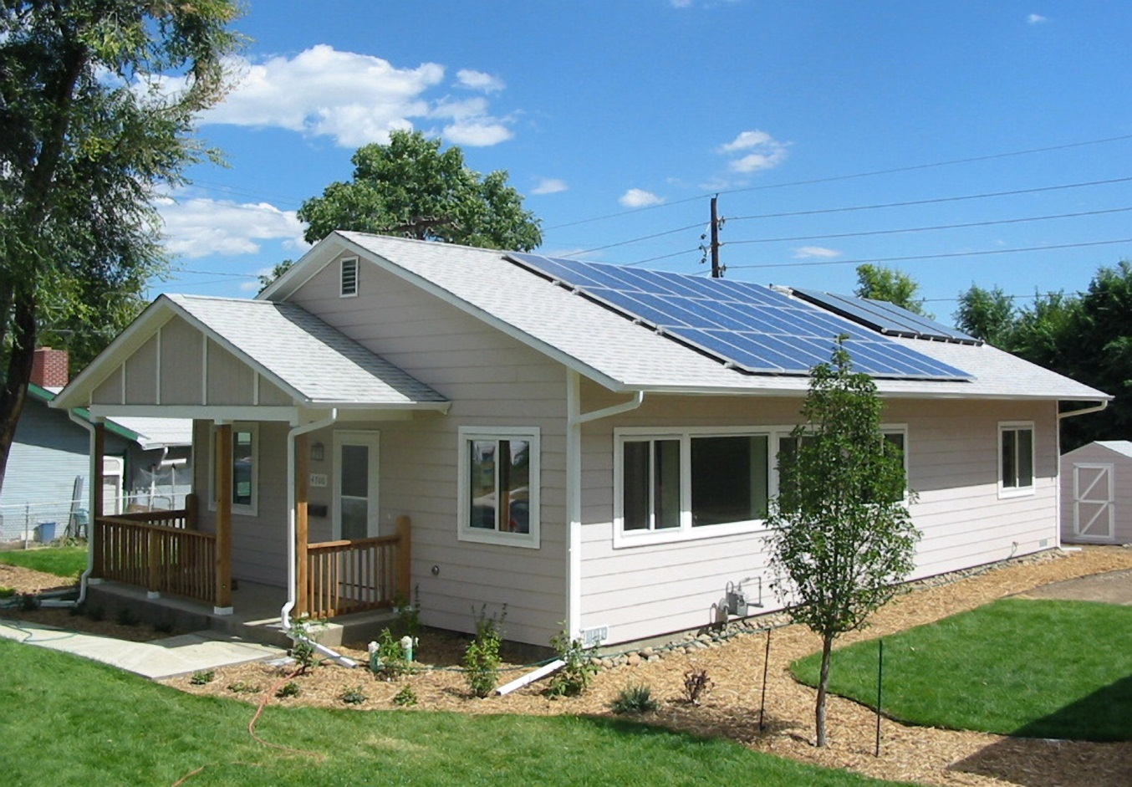

Solar for Low-income
Solar PV for low-income began to draw attention in 2015 when the price of solar became more affordable.
CEO and Grid Alternatives began negotiations for a solar PV for low-income project that led to the PUC Proceeding 16A-0139E on August 15, 2016
By August 7, 2017 the first solar system on a weatherized home was installed.

Slide 15
Goals of the Low-income Solar PV Program
Lower the Energy Burden for low-income residents in Colorado
In Colorado one-in-five to one-in-four households experience severe energy burden.
Deliver renewable energy to low-income who are typically unable to experience the electricity saving benefits.

Slide 16
Program Design
300 solar PV systems will be installed on the homes of weatherization program eligible customers through December 31, 2019
System size of 1.8 to 3.5 kW will be for homeowners or non-profit affordable housing entities
Xcel Energy will provide a $2.00/watt installation rebate
Xcel provides a production credit (or REC) to CEO of .034 cents per kilowatt for 20 years
The weatherization assistance program will pay the remaining balance up to $3,623 per system

Slide 17
Eligibility
The settlement stated that Xcel funded solar PV would be installed through the Colorado Weatherization Assistance Program
This year the Colorado WAP will weatherize 2,315 homes, and 150 will get solar PV
Income eligibility is at 200% of the Federal Poverty Level
Number of Household Members | Gross Annual Household Income
1 | $24,280
2 | $32,920
3 | $41,560
4 | $50,200
5 | $58,840
6 | $67,480
7 | $76,120
8 | $84,760

Slide 18
Numbers to Date
118 systems in the queue
103 PV systems installed
82 PV systems interconnected
245.3 kW interconnected
Average interconnected system size of 2.96 kW (Can install up to 3.5 kW)
Estimated Project Cost Average = $8,278/system (Does not include agency overhead)
Actual Project Cost Average = $8,788/system (Does not include agency overhead)

Slide 19
Location of Systems

Slide 20
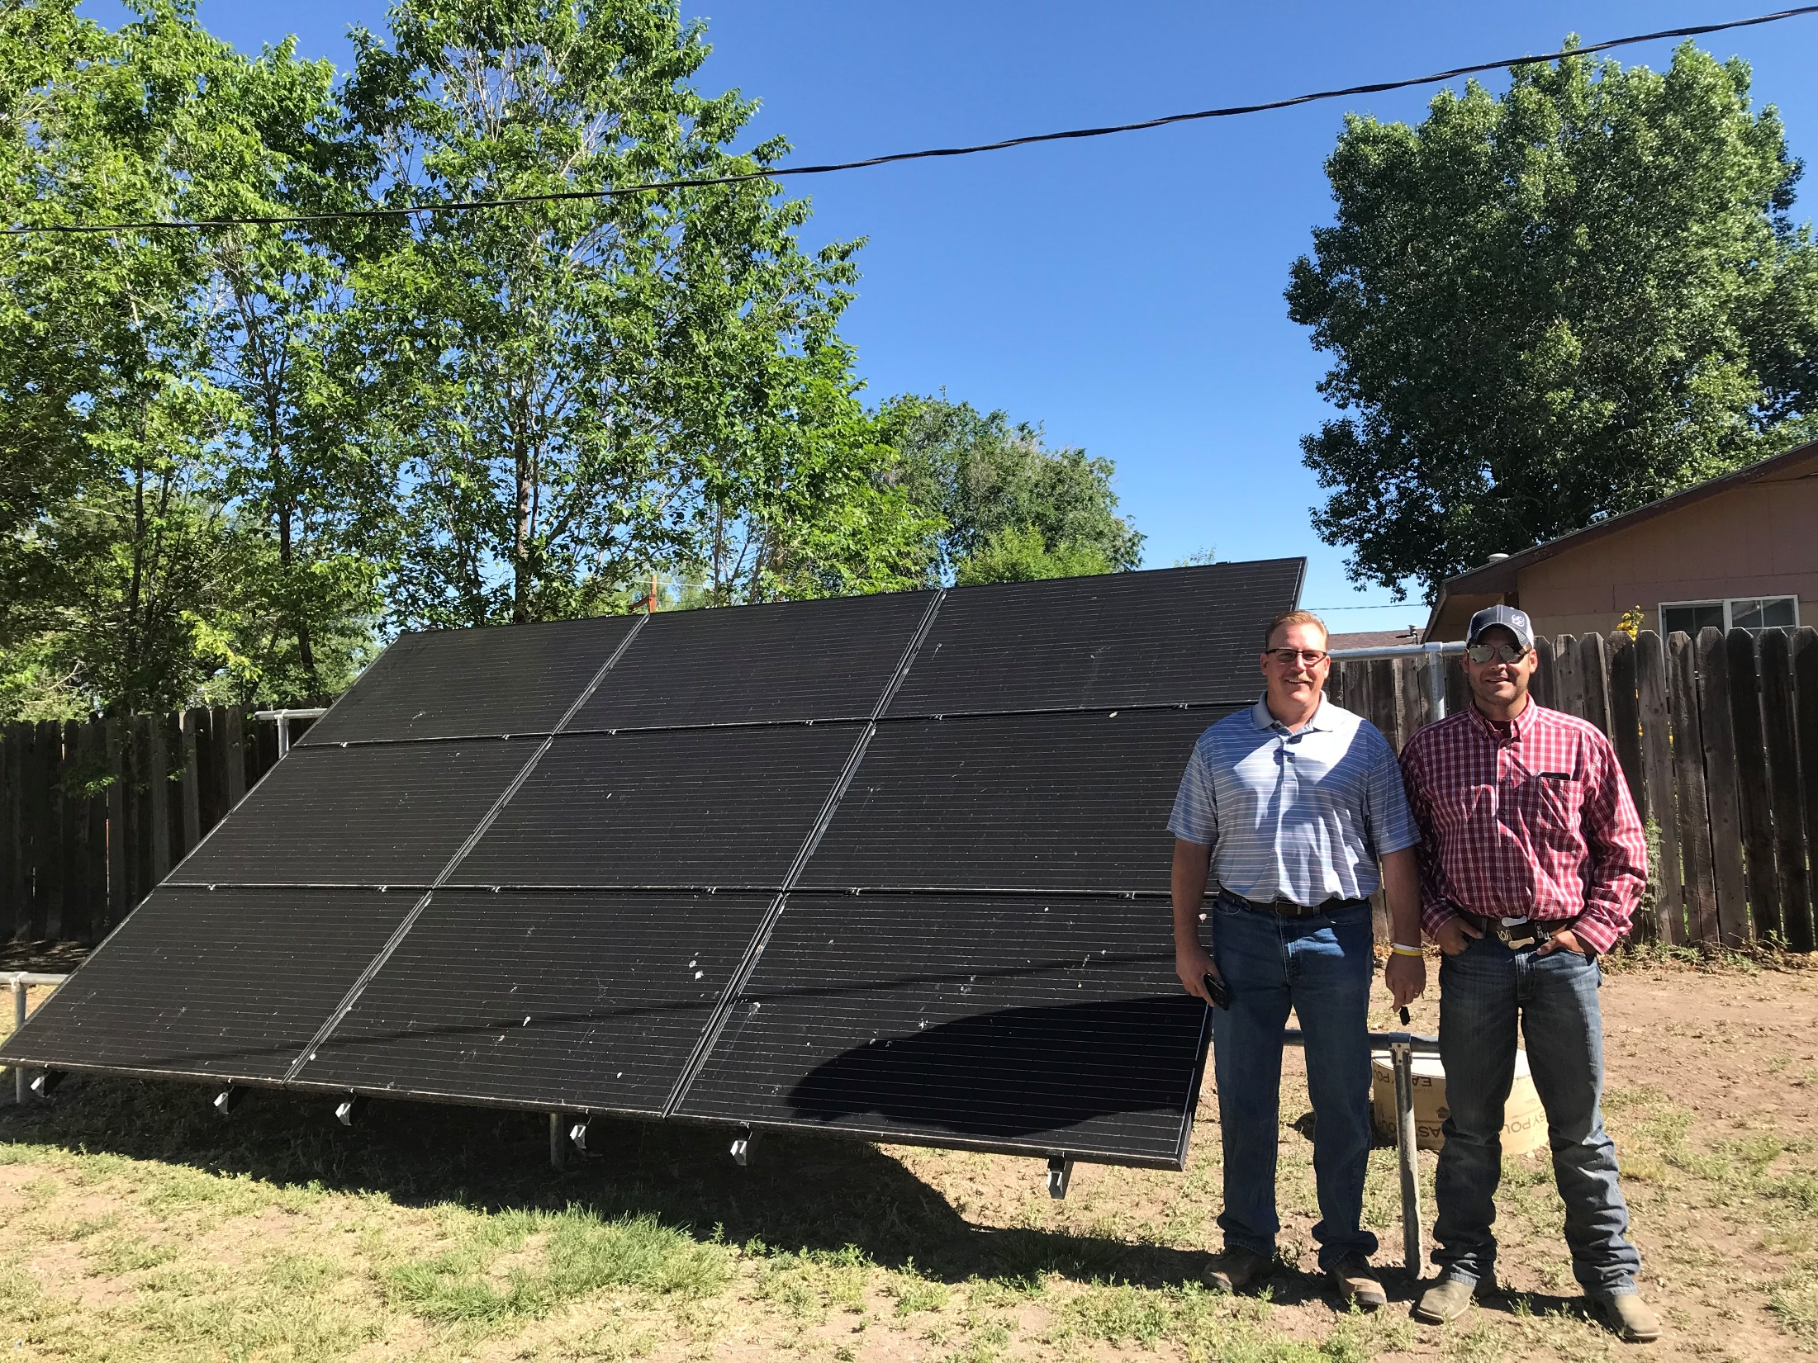
San Luis Valley, Alamosa, Colorado

Slide 21
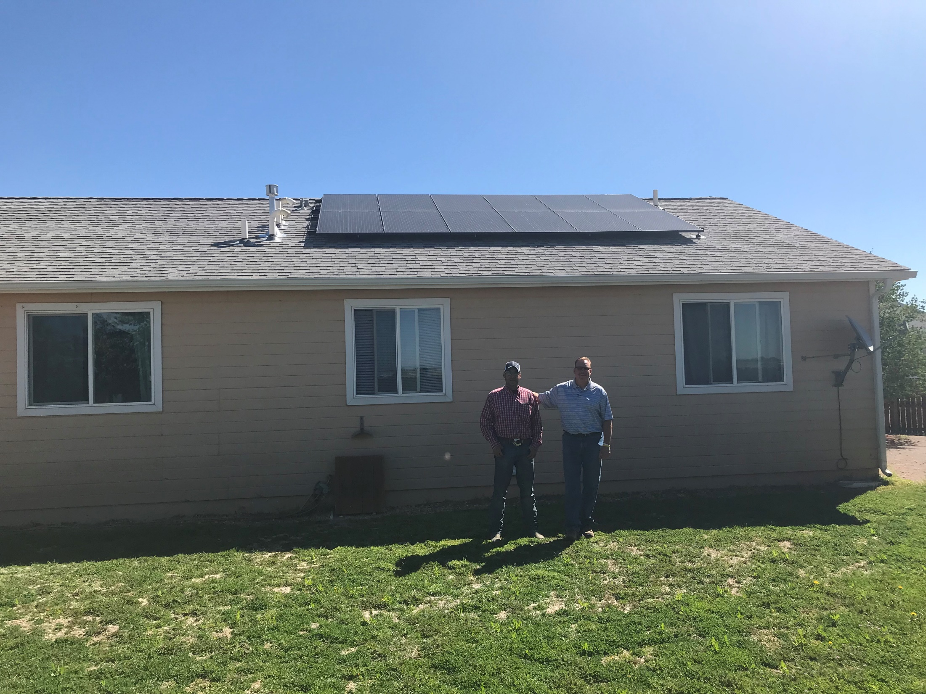
San Luis Valley, Alamosa, Colorado

Slide 22
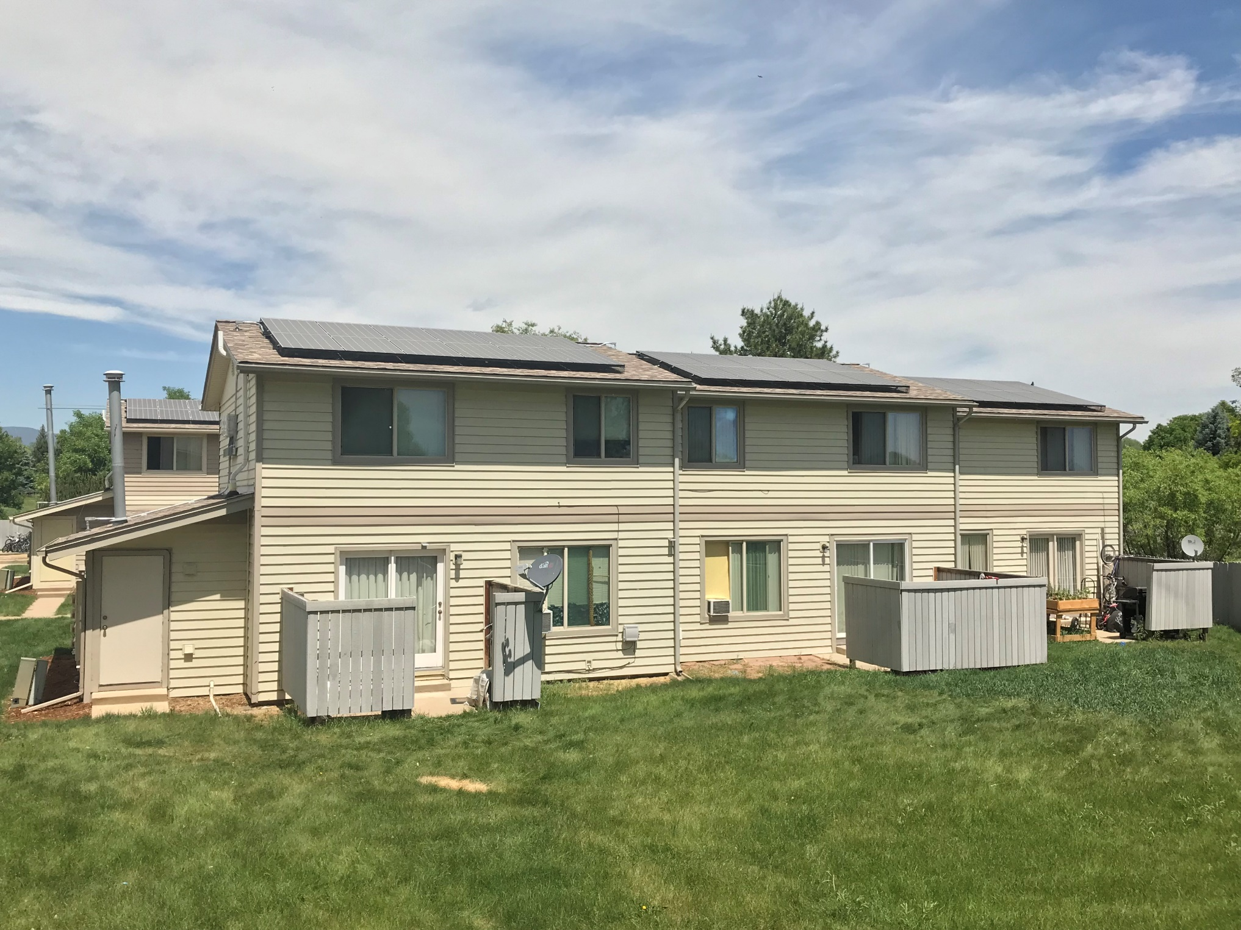
Four 3-plexes
Gunbarrel,Colorado

Slide 23
Solar Assist Grants
Electrical Panel Upgrades & Roof Repair to Address Low-income Barriers to Solar PV
Region | 2018/19 Production | % of Solar Production | Funds for Elec. Panel/Roof Upgrades
R4 –Grand Junction | 15 | 10% | $15,000
R5 –SW Corner | 4 | 3% | $4,500
R7 –Arap/Adams | 39 | 26% | $39,000
R8 –South Central | 92 | 61% | $91,500
Total | 150 | 100% | $150,000
Paid for by a grant from the Colorado Energy Office to address barriers to installations.

Slide 24
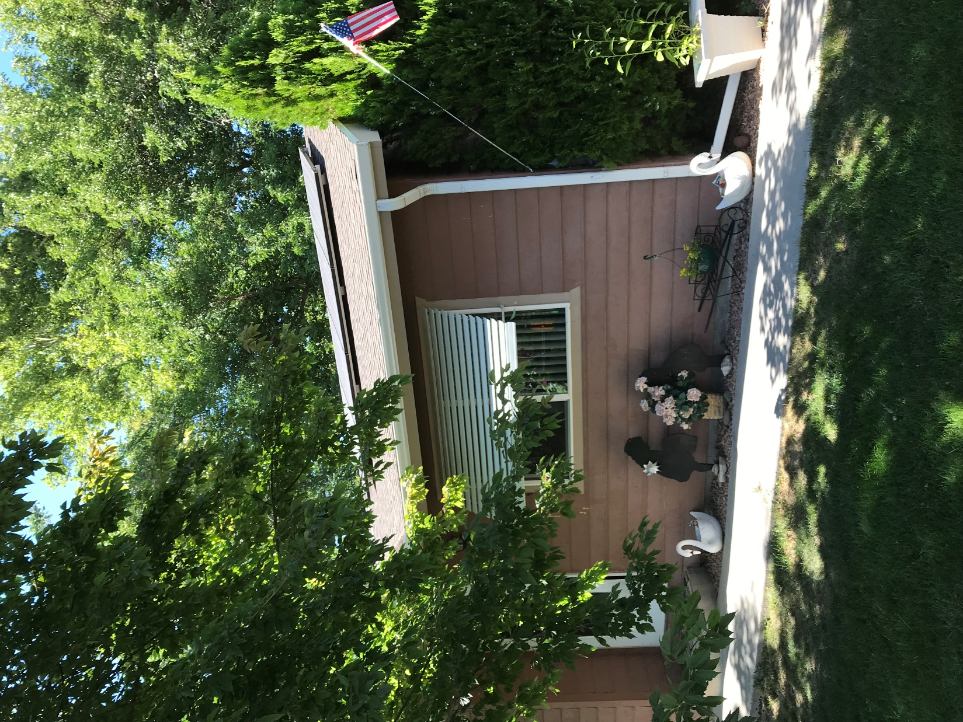
Senior couple with high electric bills.
Grand Junction, Colorado

Slide 25
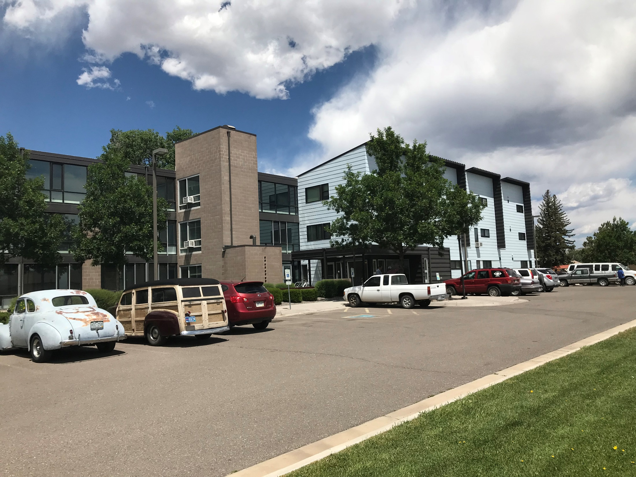
Del Norte, San Luis Valley
Potential Multifamily Solar Site

Slide 26
Questions?
300 solar PV systems will be installed on the homes of weatherization program eligible customers through December 31, 2019
System size of 1.8 to 3.5 kW will be for homeowners or non-profit affordable housing entities
Xcel Energy will provide a $2.00/watt installation rebate
Xcel provides a production credit (or REC) to CEO of .034 cents per kilowatt for 20 years
The weatherization assistance program will pay the remaining balance up to $3,623 per system
What’s next for solar for low-income and weatherization?
Solar Energy Evaluation in November 2018
Lowering the cost of solar installations

Slide 27




State of Colorado
John W. Hickenlooper, Governor
1580 Logan Street, Suite OL1
Denver, Colorado 80203
The Colorado Energy Office
@coenergyoffice

Slide 28
Solar*Rewards Community from the CSG Workshop
Combined Stakeholder Group
3
2
1
~30 Month Gap Between Project Award & Completion
1
2X capacity installed between 2017 and 2018 year end
2
Another 2X capacity installed between 2018 & 2020, with project completion closer to 18 months from award
3
Notes:
Continue to meet Medium capacity each month
Much of the orange is Duplicates and No Deposits which roll forward. You can see that capacity shrinking over time.
Medium for Q3 still has X capacity. Expect it to sell out, eventually. Are there any thoughts or reactions about International Tariffs impacting this? Podcast on EnergyGang amount I being hard to standardize (some of that being the financing).

Slide 29
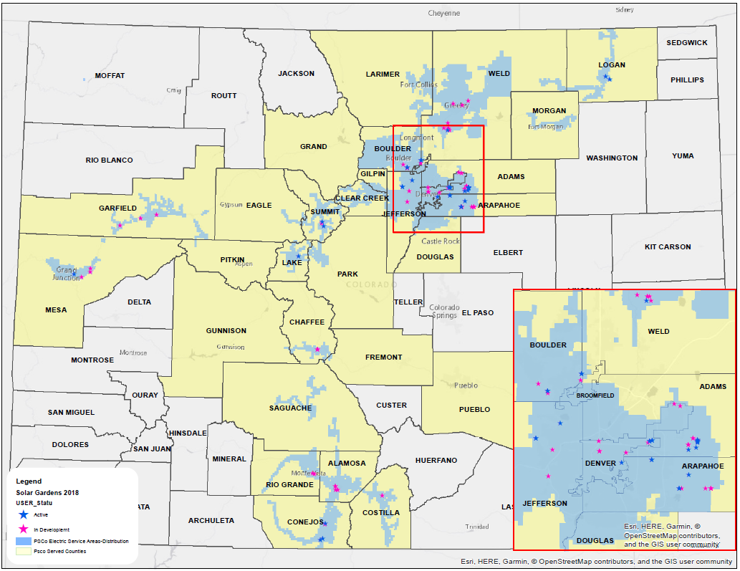
Regional Solar*Rewards Community
Combined Stakeholder Group
29

Slide 30

Solar*Rewards Community Updates
Combined Stakeholder Group
 | Mar-18 | Apr-18 | May-18 | Jun-18 | Jul-18 | Aug-18 | Sep-18 | Oct-18 | Nov-18 | Dec-18 | Jan-19
2016 S*RC SO |  |  | SO Open 5/15
2017 S*RC RFP |  | RFP Open 4/17 |  | RFPs Due : 6/1 | Awards 7/16
2017 S*RC SO |  |  |  |  |  | SO Open 8/28
2018 S*RC LI RFP |  |  |  |  |  |  | RFP Open 9/4 | RFPs Due 10/19 |  | Target Award 12/3
2018 S*RC LI SO |  |  |  |  |  |  |  |  |  |  | SO Open TBD 2019
2018 S*RC RFP |  |  |  |  |  |  | RFP Open 9/4 | RFPs Due 10/19 |  | Target Award 12/3
2018 S*RC SO |  |  |  |  |  |  |  |  |  |  | SO Open TBD 2019
30

Slide 31
Solar*Rewards Community - Standard Offers
Combined Stakeholder Group
First come, first serve:
Solar gardens up to 100 kW, with usual bill credits from SRCS Tariff
2016 Standard Offer, 1 MW available
    The full capacity is still available, after launching Q2 2018
    $0.0282/kWh REC incentive
2017 Standard Offer, 500 kW available
  Pending launch on August 23, 2018
  $0.01474/kWh REC
31

Slide 32
Solar*Rewards Community: 2017 LI & Open Program RFPs
Combined Stakeholder Group
Two separate competitive solicitations:
Low-income Solar*Rewards Community RFP
Up to 4 MW is available for projects ranging from 10kW-2MW
Projects will be evaluated with transparent scoring criteria, with 20% weight toward “Additional Non-Economic Benefits”
Open Solar*Rewards Community RFP
Up to 32 MW is available, with a minimum of 15 MW for projects ranging from 10kW-2MW
Projects will be evaluated on a number of factors including the number of solar-onsite renewable energy credits (REC) generated per year and the bid price for each REC
The proposed RFP announcement date is September 4, 2018.
32

Slide 33
2018 SRC LI & Open RFP: Proposed Timing
Combined Stakeholder Group
Proposals due
10/19/18
System operational date
6/3/2020 (18 months)
RFP Release date
9/4/18
(open for 45 days)
Review Bids/Results with PUC Staff
TBD (before awards)
Targeted award announcement date
12/3/18 (review 45 days)
Pre-bid meeting/call
tentative 9/11/18
33

Slide 34
Solar*Rewards Community – LI RFP Scoring Sub Group
Combined Stakeholder Group
Subgroup Conversations Requests:
Transparent Scoring (Plans to incorporate)
  Showing the scoring criteria in the RFP and providing individual feedback to developers that request information
Net Bill Reduction (Challenges with compliance and enforcement)
  Including bill reduction percentage as major evaluation in the RFP
Incorporate Additional evaluation of non-economic criteria (Plans to incorporate)
  Provisions for solar installation job training and coordinated installation of energy efficiency measures
Subscriber Participation Mix (More information/time is needed to understand if there is a gap)
  Require a mix of residential and master metered subscribers
34

Slide 35
Solar*Rewards Community – LI RFP Scoring Sub Group
Combined Stakeholder Group
Economic Criteria | 50
REC Price | 50
Non-Economic | 50
Additional LI Commitment (Bill Reduction, Job training, EE, etc.) | 20
Energy & REC Production | 15
Developer Experience | 15
Other (tie breakers)
Geographic
Construction Milestones
35

Slide 36
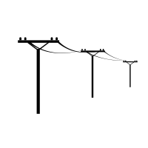


Residential Battery Demand Response Pilot (DSM)
Combined Stakeholder Group
Objectives
Company Details
Customer Details
Integrate batteries into utility systems
Test battery availability and performance
Evaluate customer preferences
Manages 50% of battery for up to 100 events
Integrates vendors into DRMS
Year-round DR: summer peak reduction, spring solar time shifting, fall/winter renewable integration
Filed at end of August in the 2019/2020 DSM Plan
Customer buys or leases battery
Xcel provides $500 upfront + $10/mo. Rebate
Up to 500 customers
2 year pilot, includes early termination clause if customer takes credit and leaves pilot
36

Slide 37



Geo-targeting (DSM)
Using energy efficiency and demand response to defer or avoid the need to invest in a traditional distribution solution (e.g., transformer)
2019
2020
2021
2022
Invest
Current Status
  Filing geo-targeting pilot in 2019/2020 DSM Plan
  Focuses on deferring new transformer and feeder
  Targets Kendrick feeder located in Lakewood/Rooney Valley area
  Uses demand reduction from three sources:
    Existing residential DR
    Energy efficiency (EE) and DR through programs targeted at new construction in Rooney Valley
    New EE and DR targeted at existing homes, acquired during a concentrated community-based marketing campaign carried out in 2020
37

Slide 38
Renewable*Connect Post-Enrollment Survey
Methodology: Online Customer Survey
Survey launch: June 4, 2018
Survey closed: July 27, 2018
Number of emails sent:
3,186
Response Rate:
19%
Colorado Residential Customers Who Enrolled in Renewable*Connect® and Responded to Our Survey
610
38

Slide 39
Renewable*Connect Post-Enrollment Survey
Seventy-five Percent of Respondents Say Early Coal Retirement is an Important and High Priority Issue
N=601
Q. How important an issue do you believe early coal plant retirement is?
39

Slide 40
Renewable*Connect Post-Enrollment Survey
Only a Few Respondents (26) Were Not Interested in Early Coal Plant Retirement – Even if $0 Cost
N=26
Q. You said you weren’t interested in early coal plant retirement even at no additional cost. Why?
40

Slide 41
Renewable*Connect Post-Enrollment Survey
Majority of Respondents Expressed Interest in Contributing a Small Amount Towards Early Coal Retirement
Q. If Xcel Energy offered a simple way for you to contribute a small amount towards funding early coal plant retirement, how interested would you be in participating at the following price points?
41

Slide 42
Key topics
New Mexico Solar*Connect Community
  2 MW solar gardens program, filing soon
  Successor to Windsource
  Includes opt-out customer transition
Windsource future
  Still looking at merging WS with R*C (e.g. NM S*CC)
  Developing in MN
Green-e
  15 year new date doesn’t align with green tariff design, asking for an exception.
LI Solar Gardens
  Still developing
  More to come . . .
42

Slide 43
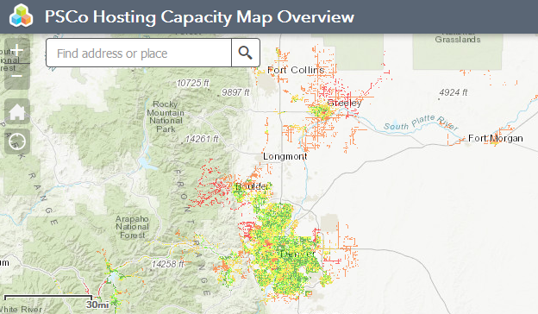
Hosting Capacity Map/How to Interconnect Page Feedback
Combined Stakeholder Group
How to Interconnect Page
Hosting Capacity Map
43

Slide 44
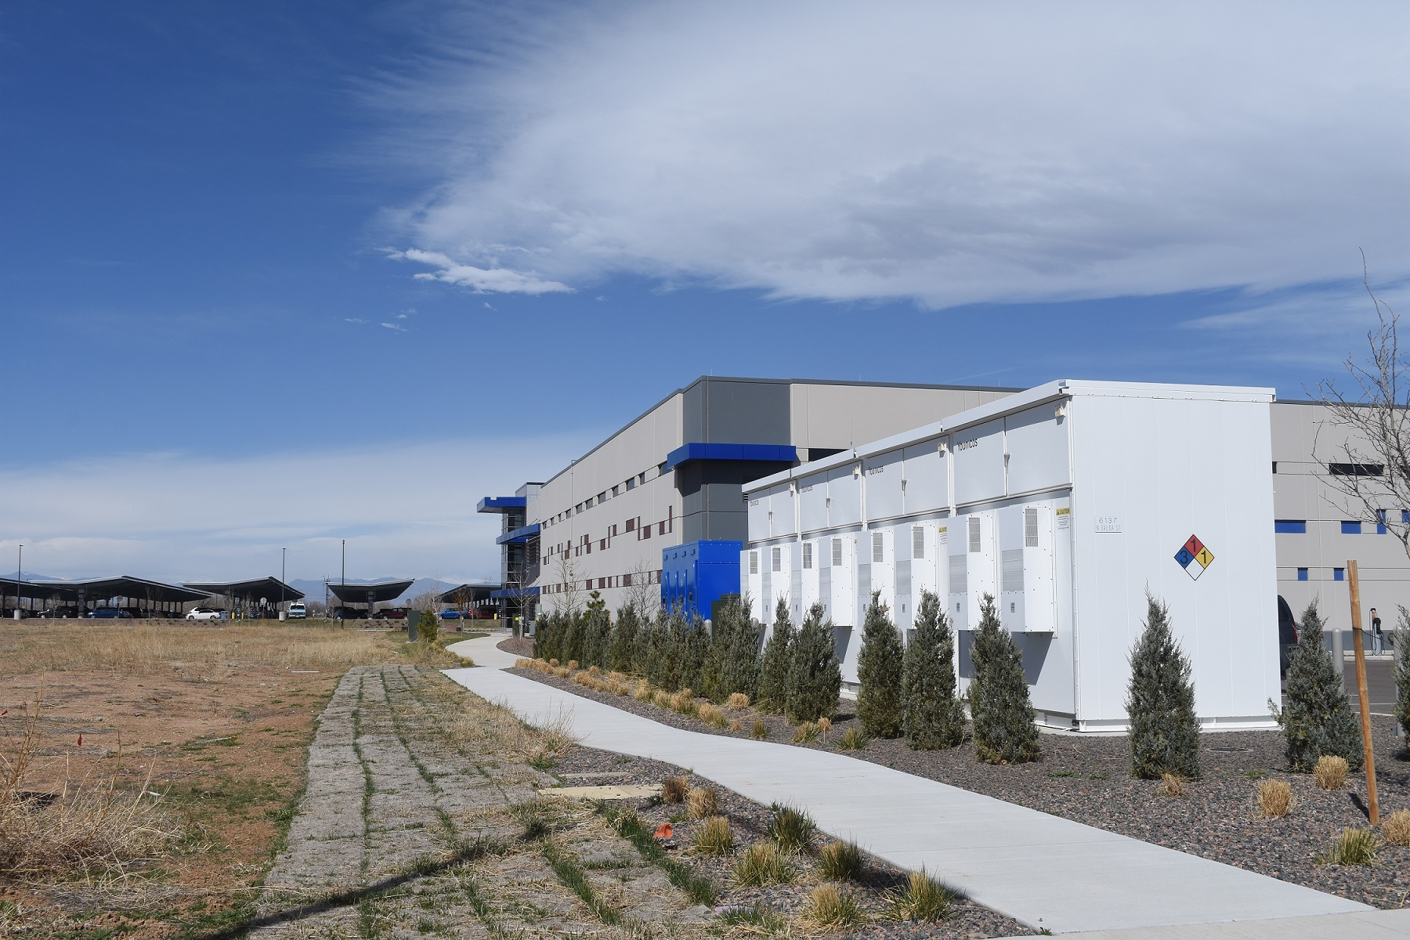
Innovative Clean Technology Stakeholder Group
Battery Energy Storage Updates
August 24, 2018 (12:30 – 1:15PM)

Slide 45
Agenda
ICT Stakeholder Group
Project Introduction & Updates
Demonstration, Results & Lessons Learned
Wrap-Up

Slide 46
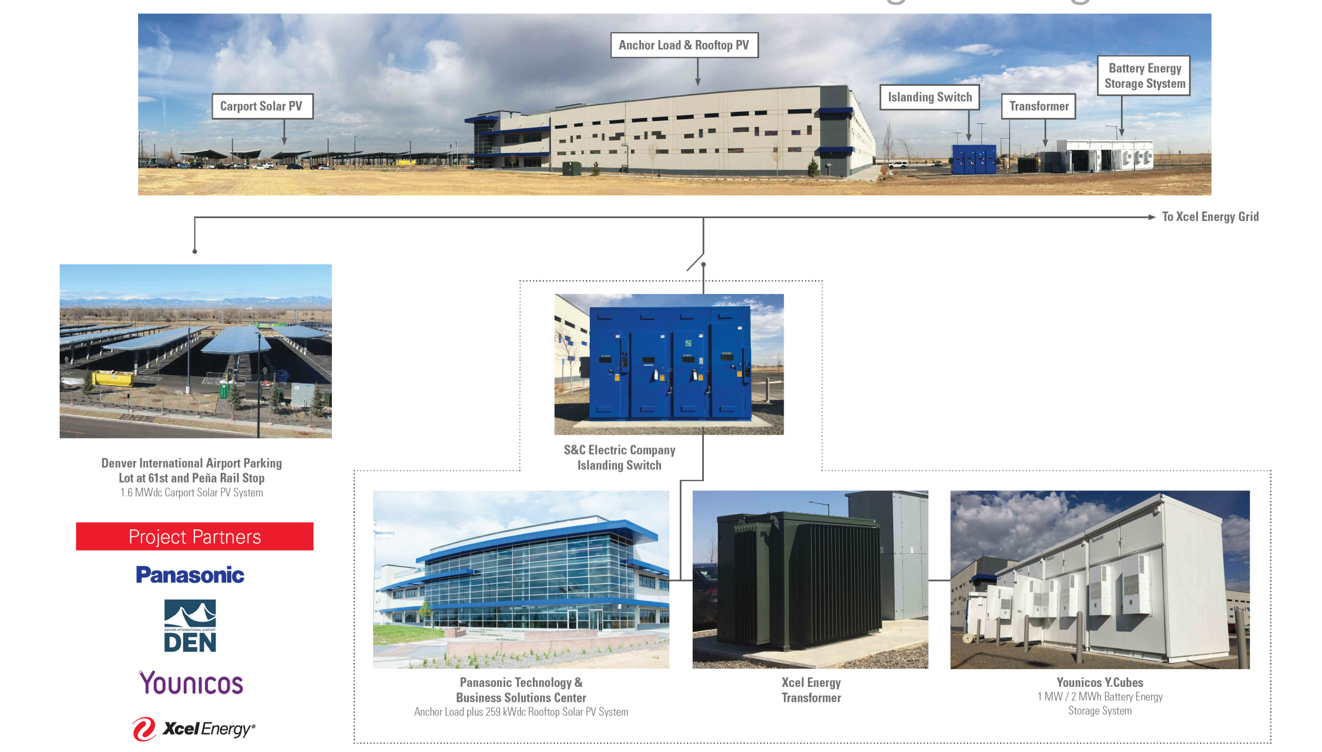
Peña Station/Panasonic Project
ICT Stakeholder Group
3.376 kVA PV on feeder
Younicos T.Cubes
1MW/2MWh

Slide 47
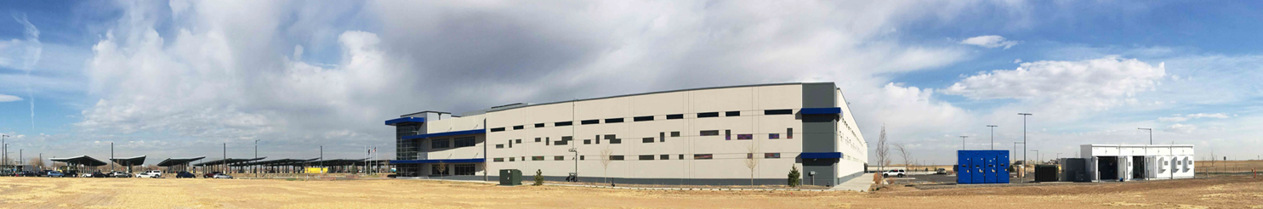
Panasonic Project Use Cases
ICT Stakeholder Group
Microgrid/Islanding of Panasonic building
Peak Demand Reduction
Energy Arbitrage
Frequency Response
Voltage Regulation
PV Ramp Rate Limiting

Slide 48
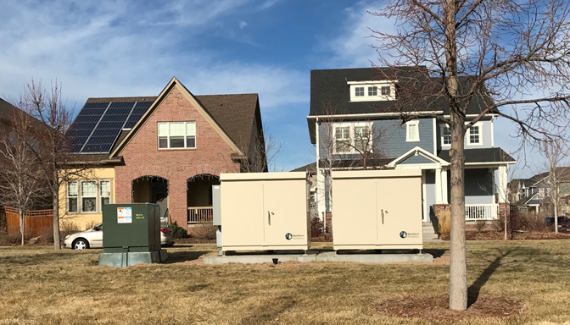
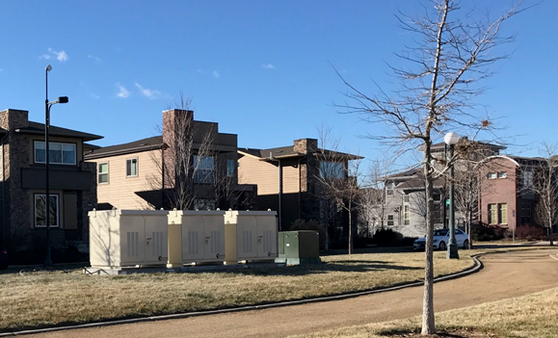
Stapleton Utility-Sited Project
ICT Stakeholder Group
Northern Reliability Modular Units:
  2 x 18 kW/69 kWh
  2 x 36 kW/138 kWh
  2 x 54 kW/207 kWh
Objectives/Use Cases:
  Peak Demand Reduction
  Voltage Regulation
  Solar Time Shifting
  Energy Arbitrage
  Stapleton feeder has ~18.5% PV penetration (2017)

Slide 49
Demonstration,
Results &
Lessons Learned
ICT Stakeholder Group

Slide 50
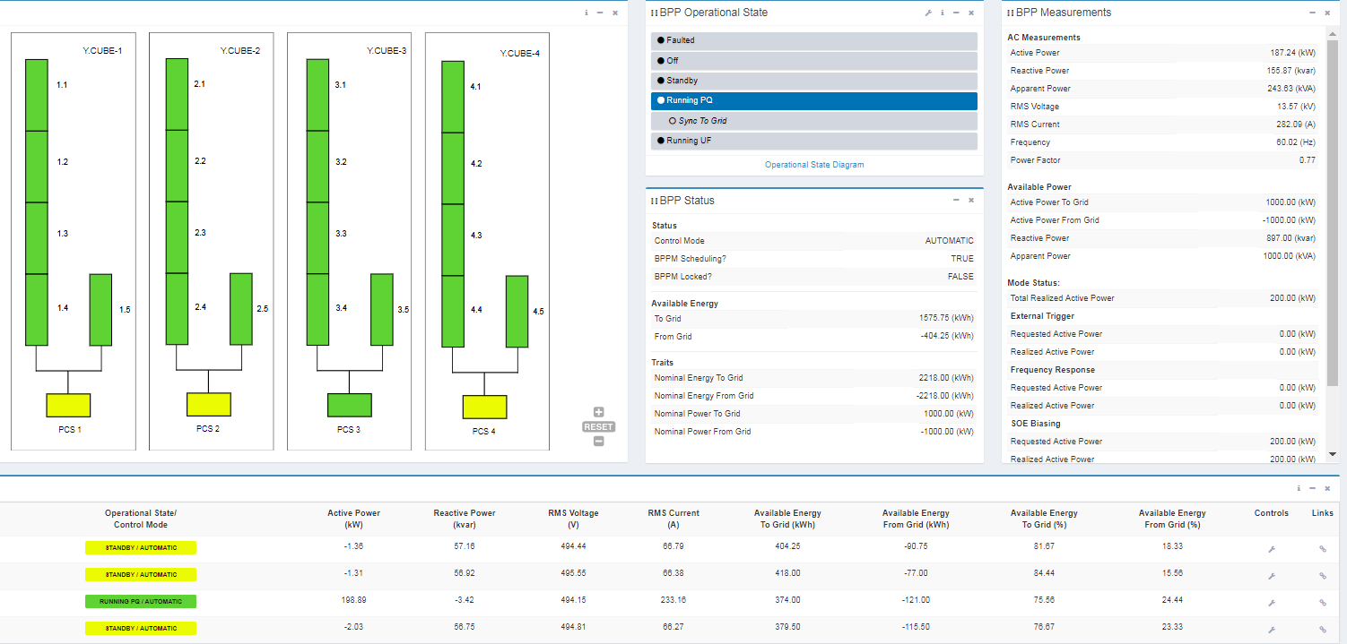
Demonstration: Panasonic Web UI
ICT Stakeholder Group
Notes:
https://10.60.39.209/bronco/Home

Slide 51
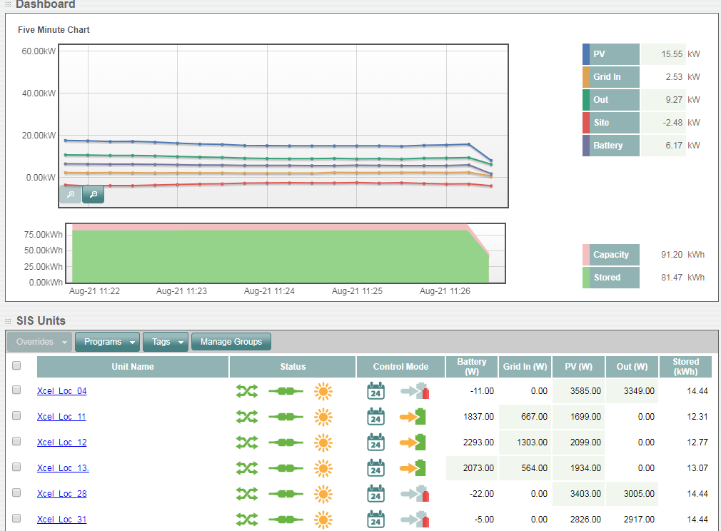
Demonstration: Sunverge Web UI
ICT Stakeholder Group
Notes:
https://sis.sunverge.com/marge/dashboard?site=xcelenergy

Slide 52
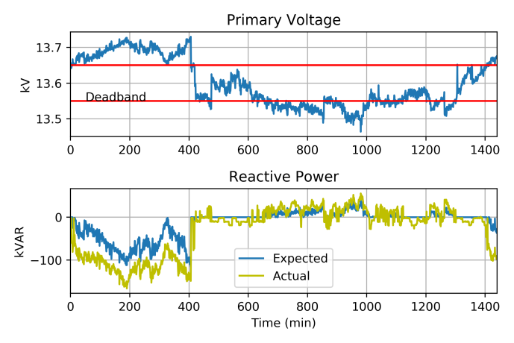
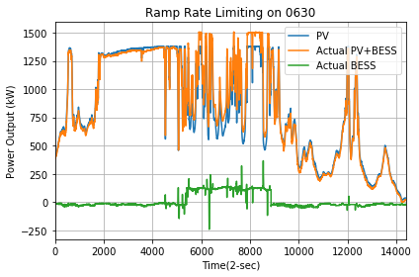
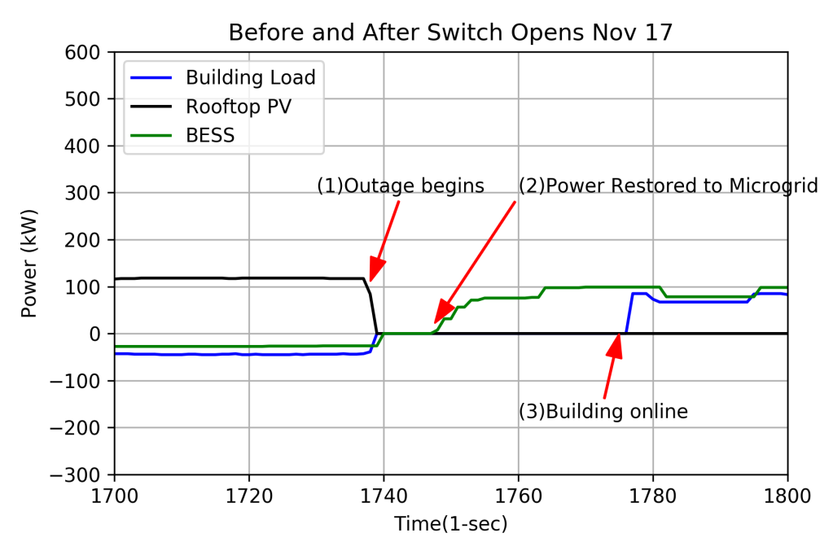
Panasonic Testing Results
ICT Stakeholder Group
Operation | Performance | Impact on Grid
Voltage Regulation | Good | Minimal
Peak Demand Reduction | Good | Moderate
Energy Arbitrage | In testing stage
PV Ramp Rate Limiting | Good | Moderate
Frequency Response | In testing stage
Microgrid | Good | Extensive
Detailed results can be found in the 2018 Semi-Annual Report to the Colorado Public Utilities Commission Regarding the Innovative Clean Technology Program Proceeding No. 09A-015E

Slide 53
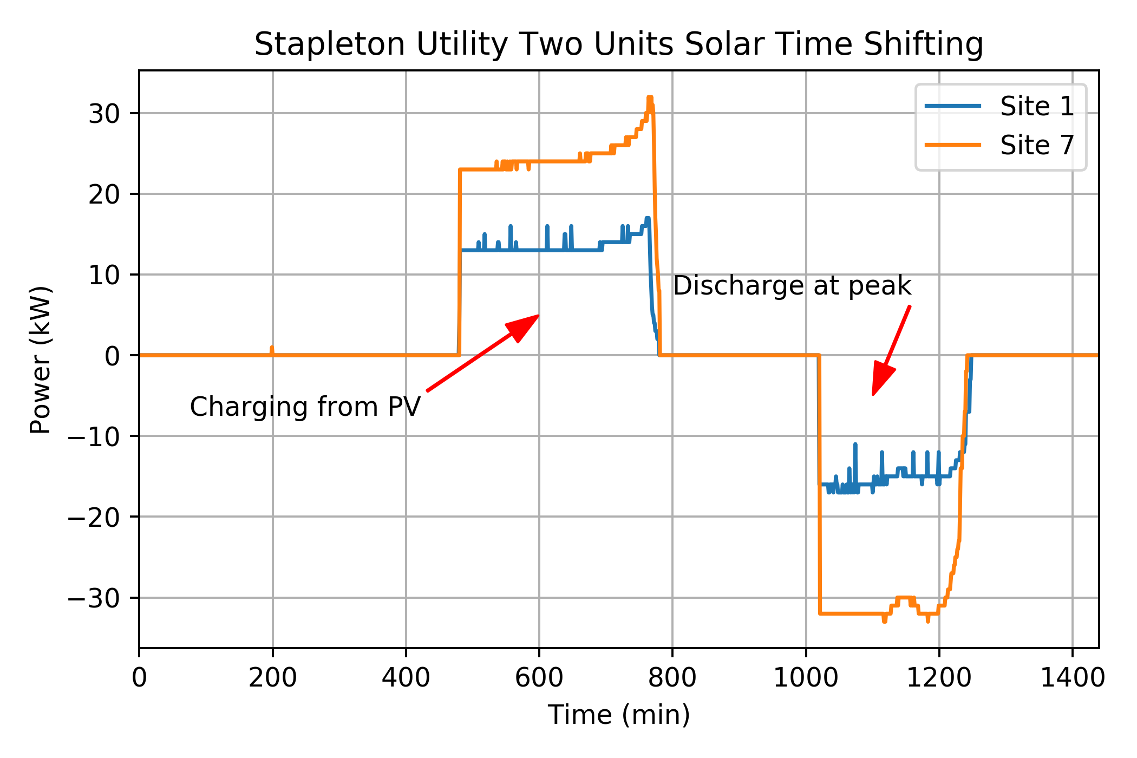
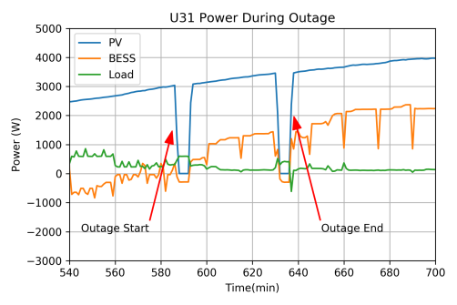
Stapleton BTM Testing Results
ICT Stakeholder Group
Operation | Performance | Impact on Grid
Solar Time Shifting | Good | Moderate
Peak Demand Reduction | Good | Moderate
Solar Ramping | Good | Moderate
Customer Backup | OK | Extensive
Detailed results can be found in the 2018 Semi-Annual Report to the Colorado Public Utilities Commission Regarding the Innovative Clean Technology Program Proceeding No. 09A-015E

Slide 54
Stapleton Utility-Sited Testing Results
ICT Stakeholder Group
Operation | Performance | Impact on Grid
Solar Time Shifting | Good | Moderate
Voltage Regulation | In testing phase
Peak Demand Reduction
Energy Arbitrage
Detailed results can be found in the 2018 Semi-Annual Report to the Colorado Public Utilities Commission Regarding the Innovative Clean Technology Program Proceeding No. 09A-015E

Slide 55
Lessons Learned
ICT Stakeholder Group
Implementation and Integration
  Adapt learnings for future battery projects
  Different vendor platforms→ cyber security, customization
  Integration between different devices and systems
Inform Future Projects
  Batteries potential for mitigating feeder issues related to high PV
  Residential battery storage as demand response resource
  Non-wired alternative
  Cost-effectiveness
Several new processes for new technologies
  Customer sited technologies
  Siting smaller systems in neighborhoods
  Training
Environmental controls
55
Notes:
Implementation:
1) We learned a lot about these systems through the actual installation process, how we integrate these types of systems into our distribution network. We were even able to adapt what was learned at Panasonic to facilitate the Stapleton utility installations
2) Vendor platforms are not uniform and different from each other, have to customize implementation of systems within the distribution system operation as well as cyber security needs
3) Integration of different systems together e.g. demand response aggregator and the Panasonic as well as the utility-sited batteries
Future projects:
1) The experience we gained has made us more comfortable in looking for other battery storage opportunities. For example, we now consider battery storage in our “tool-kit” when we look to mitigate problems caused by high penetration of solar. We consider whether battery storage can address feeder issues.
2) We will be offering a pilot in the next DSM plan to leverage residential battery storage as a demand response resource. This pilot was informed in some part by the Stapleton BTM project.
3) Considering our experience with these systems, we are evaluating utilizing battery systems as a non-wires alternative
4) Battery costs are still at a point where they are seldom the least cost solution to problems on the distribution grid, but we are in a much better position to leverage this technology when it becomes cost effective.
New processes:
1) Training for the operators and control room
Environmental controls:
1) Lithium-ion systems are sensitive to extreme cold and hot temperatures, very important to have the proper HVAC mechanism to ensure the safety and longevity of the systems.

Slide 56
Wrap Up
ICT Stakeholder Group
Q & A
Review Action Items
Future Agenda Items
56

Slide 57
Combined Stakeholder Group Wrap Up
Combined Stakeholder Group
Review Action Items
Future Agenda Items
Next Meeting Scheduled for November 16th
57

